Slide 1

Web scraping to gain company insights
KEHINDE OLALEKAN – DATA SCIENTIST
09/05/2025

Slide 2

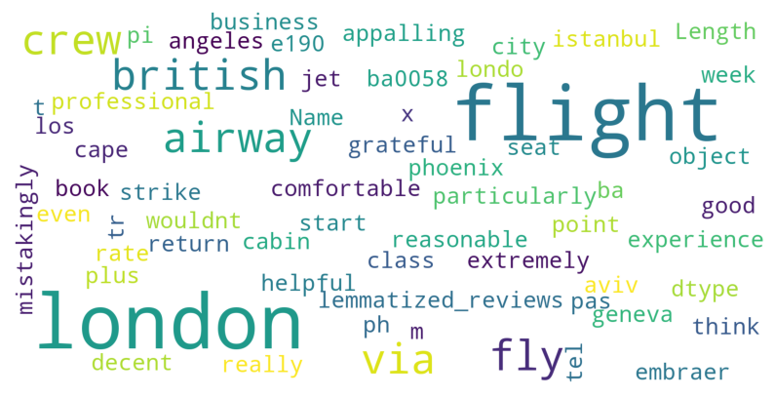
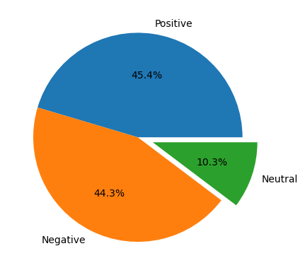
INSIGHT FROM THE CUSTOMER’S REVIEWS
From cleaning 1000 reviews given by the customers, we obtained:
Positive Reviews - 454
Negative Reviews - 443
Neutral Reviews - 103

